Slide 1
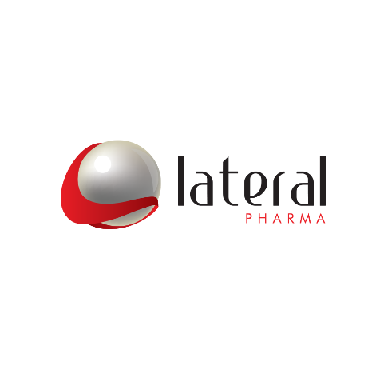
Bioshares Summit -
Neurological Power Therapies
Key Points
Leveraging the breakthrough discovery of a new host-protective biological pathway
First-In-Class peptides and mimetics to treat neurological disorders

Slide 2

Utilising a new Host-Protective Biological Pathway
to Improve Health
Novel
Drugs
Discovered multiple peptides derived from human and bacterial proteins that bind to a novel target with an excellent safety & efficacy profile
Novel
Target
Lanthionine Synthetase C-like family (LanCL) are highly conserved over evolution. These targets are implicated or validated in
neuropathic pain, AD, ALS, obesity, inflammation, IBD and diabetes
Impacts Cell
Health
First-in-Class LAT peptides bind to LanCL to selectively restore cell health under conditions of stress and cellular damage
Therapeutic
Benefit
Results in improved disease trajectory in models of
neuropathic pain, obesity, OA & severe respiratory diseases

Slide 3
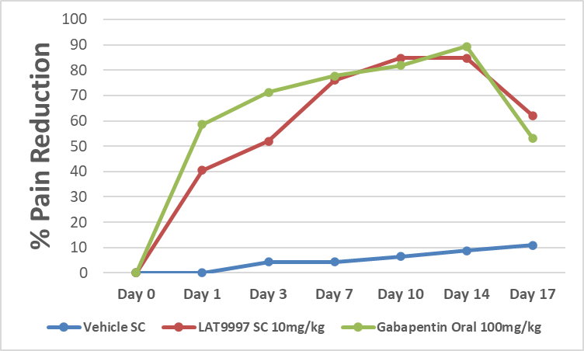

Nerve Ligation model - Cumulative impact of daily SC dosing
LAT9997 has comparable efficacy to high dose Gabapentin
Pain relief peaks
≈10-14 days post-surgery and continues for over 3 days post dosing
Proven safety and efficacy in a phase 1b human clinical trial in the treatment of neuropathic pain with a LAT9997 parent peptide
No drugs in late-stage clinical trial pipelines looks promising
Last Day of Dosing
Pain
Relief without sedation
*
*
*
*
*
*
Surgery
* p<0.001 compared to vehicle control, one-way ANOVA, n = 7 or 8 per group

Slide 4
Key Points
Discovered a Platform technology based on a host-protective biological pathway
Targeting large neurological disorder markets:
  Neuropathic pain and Alzheimer’s disease
Significant potential in several other indications where LanCL is the target
Capital raised $25m to date, CEO has invested $10m
Now raising $15m for:
  Neuropathic pain - Clinical development of sub-cut LAT9997
  Alzheimer’s disease – Preparing a preclinical data package with Prof Michael Heneka, Director of the Luxembourg Centre for Systems Biomedicine
  Oral and next-Gen drugs - Improved peptides and peptide mimetics

Slide 5
Contact Details:
David Kenley, CEO
P: +61 400 151 490
E: dk@lateral-pharma.com

